Slide 1
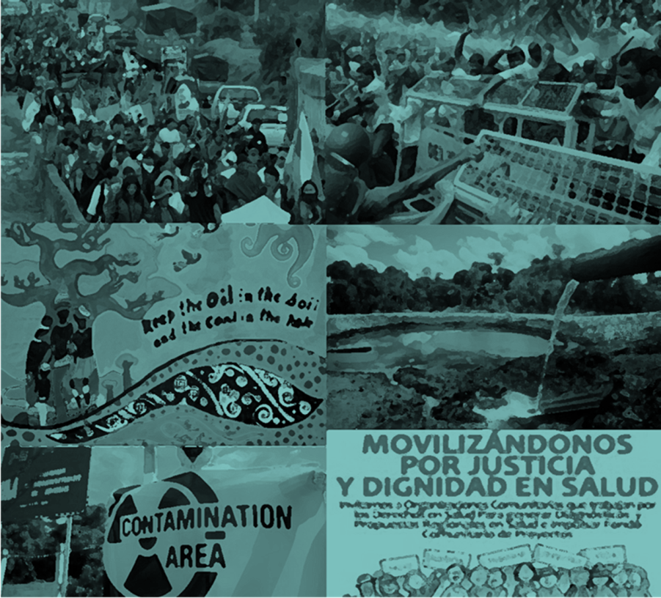
Health As Dignity
Risks, Health And Mobilizations For Environmental Justice
Marcelo Firpo
ENSP/FIOCRUZ
marcelo.firpo@ensp.fiocruz.br

Slide 2
Health: concepts and tools
Biomedical view: preventable diseases and deaths
Classical scientific tool: epidemilogical studies and causal nexus
Limits of ‘normal science’ and epidemiological studies
Some alternatives
Independent studies and counter-expertise
Popular epidemiology
LA: Critical epidemiology and Environmental Clinic

Slide 3
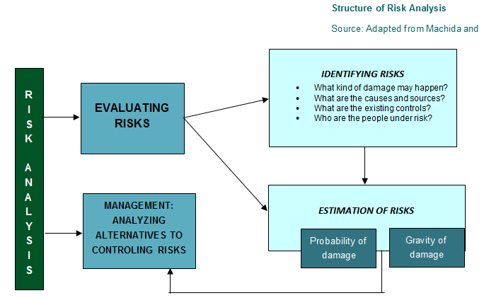
Risk: Concepts and Tools
Applications: Environmental licencing, management, prevention emergency measures and mitigation.
Limits: Who decides? Under what criteria? How the most affected groups participate in the decisions?
In general doesn’t take into consideration local non-specialized knowledge
Obscures the connection between scientific and political values
Alternatives:
Counter-expertise: deconstructing hegemonic and false arguments that “risks are under control”;
Combat double standards by multinational companies
Incorporation of situated and local knowledge of workers and populations (for example CBPR)
Vulnerability studies and issues on environmental inequalities and EJ

Slide 4
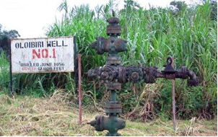
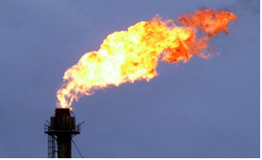
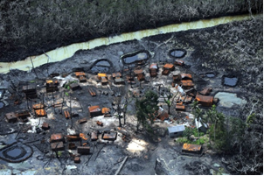
The Shell Case: main risks of oil extraction and production
High risk in all activities (offshore & onshore): survey; drilling and exploration; production in refinaries; storage; transportation by tanks etc
Innumerous hazardous chemicals: crude oil, metals, benzene, Nox, Sox, CO ...
Accidents and disasters: spills, fires...
Double standards and lack of infrastructure maintenance.

Slide 5
The Shell Case: Health problems
UNEP Report: Groundwater contamination; Air pollution; Fish; Crops...
Association between contamination derived from oil spills or air pollution and increased prevalence of diarrhea, eye irritation, itchy skin, occupational diseases, severe kidney failure, skin diseases, conjunctivitis, esophagitis and chemical pneumonia
Expected increase of infertility, hemotoxicity, hepatotoxicity, and carcinogenesis.
Lack of epidemiological studies
Very poor health data systems
Violence

Slide 6
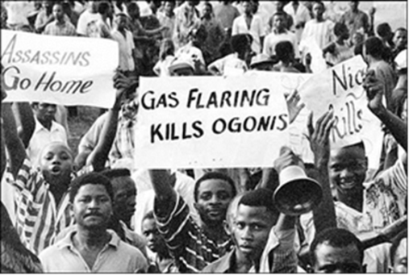
Shell case: vulnerabilities and alternatives
VULNERABILITIES
State/ Federal Goverment: concentration of power, use of violence to protect oil exploration
Institutional vulnerability: regulation, prevention and mitigation; Health System
Political desestabilization, interethnic rivalries
Huge revues of companies versus non investments on institutions and population needs
ALTERNATIVES & CHALLENGES
Local mobilizations linked with various local international nongovernmental organizations (NGOs); publicitation of the Ogoni struggle
Financing risk and health assessments and clean up operations BUT in cooperation with local population/local knowledge. E.g. popular epidemiology, CBPR etc.
Building up more independent regulatory and technical institutions; cooperation EC with universities and NGOs
Issues on democracy and participation: considering the needs and aspirations of the minorities of the Niger Delta.

